Slide 1
Introduction to EMS and Environmental Awareness
ISO 14001:2015
October 24, 2022

Slide 2
About Us
Our Experience
Certified environmental auditor (CEA) and Environmental Professional (EP)
Over 20 years of experience in environmental compliance
Worked with various industries in developing an EMS
Envirolum Consulting Inc. is a small environmental consulting boutique with a mission to assist our clients to become a sustainable leader within their industry and excel in environmental compliance.

Slide 3
Introduction
The objectives of this training are for LDI Management staff to:
Gain a general understanding of environmental management systems (EMS)
Understand the basic elements of ISO 14001:2015
Be trained to execute General EMS Awareness Training
The objectives of general EMS Awareness Training for LDI Staff is to:
Gain a general understanding of environmental Managements systems (EMS)
Understand how to identify environmental aspects and impacts
Describe EMS responsibilities and how it applies to an LDI worker’s day-to day activities.

Slide 4
Agenda
PART 1: Train the Trainer
Introduction to EMS and ISO 14001:2015
Elements Overview of ISO 14001:2015
Benefits of EMS
Keys to Success
PART 2: General EMS Awareness Training

Slide 5
PART 1: Train the Trainer
Introduction to ISO 14001:2015 and EMS

Slide 6
International Organization for Standardization
ISO is the International Organization for Standardization
Standards developed for international use.
ISO 9001 – Quality Management System
ISO 14001 – Environmental Management System
Global standards are necessary so everyone can be equally measured.

Slide 7
What is ISO 14001?
ISO 14000 is the generic term for the series of international standards for environmental management.
ISO 14001 EMS = framework for setting up a management system to assure a company’s environmental impact is being measured and improved
ISO 14001 implementation requires an organization consider all environmental issues relevant to its operations:
employees
air pollution
water and wastewater issues
waste management
soil and groundwater contamination
climate change mitigation and adaptation
resource use and efficiency
supply chain
ISO 14001 has 17 elements that must be present for an EMS to be in conformance
Certification attained through effective and successful implementation of an EMS.

Slide 8
Why Develop and Implement an EMS?
CURRENT SITUATION
Out-of-date EMS.
2020 a Gap analysis was conducted against requirements to comply with the standard. Non-conformances were observed.
PURPOSE
Impala Platinum group of companies are certified against ISO 14001:2015.
Increase Impala Canada’s ability to comply with environmental legislations and increase stakeholder confidence.
SUCCESS MEASURE
ISO 14001:2015 certification.
EMS implementation.
Provide the company with a framework through which its environmental aspects and impacts are monitored, improved and controlled.
Improve regulatory compliance, emergency preparedness, response procedures and EM documentation.
Reduce business risk by establishing legal obligations, managing environmental and employee risks.
Improve environmental awareness, increased employees’ involvement, and increased employee training and knowledge.
Overcome environmental challenges, decrease threats to environmental performance, drive these responsibilities through the Company’s supply chain and ultimately impart a culture of environmental awareness and improvement.
Current policies, manuals and procedures do not comply with specific ISO requirements.
Lack of EMS Documentation System and formal monitoring system.
Absence of objectives and targets to mitigate environmental aspects.
Notes:
Also demonstrates leadership in your industry.

Slide 9
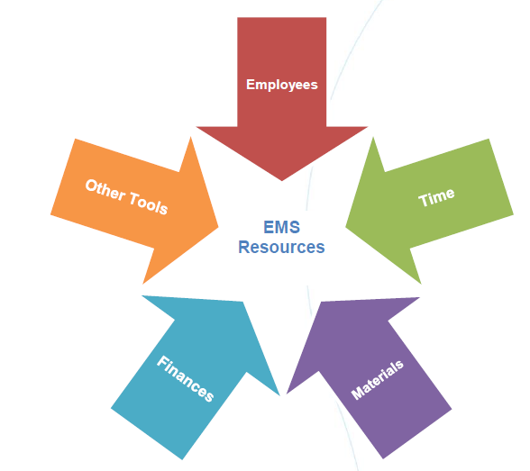
Timeline to ISO 14001 Certification
Approach | Tasks | Duration
Preparation - Initiation | Baseline assessments | 2 - 4 months
Management Commitment |  | 1 - 2 months
PLAN | Environmental Aspect (EA) identification | 1 month
 | Identification & compliance with legal and other requirements | 2 months
 | Evaluating environmental aspects | 2 months
 | Developing Objectives & Targets with Programmes | 1 month
DO | Developing EMS documentation | 2 - 4 months
 | Developing operational control procedures | 2 - 4 months
 | Implementation of the EMS | 2 - 4 months
CHECK | Checking, audit and management review | 2 - 4 months
ACT | External Audit | 2 - 4 months
 | Estimated Project duration | 12 – 24 months
ISO 14001 Certification
Corporate requirement to become certified in ISO 14001:2015 by Spring 2024.

Slide 10
Resources Required
Cross-functional Environmental Committee required (to ensure successful implementation)
A team with representatives from key functions can identify and assess issues, opportunities, and existing processes.
A cross-functional team can help to ensure that procedures are practical and effective and can build commitment to and “ownership” of the EMS.

Slide 11
Roles and Responsibilities
Senior Leadership
Provide strategic vision
Commits to compliance, prevention of pollution and continuous improvement
Allocate resources
Assigns responsibilities
Review system effectiveness / adequacy
Ensure deficiencies are corrected
Direct change when required

Slide 12
ISO 14001 Roles & Responsibilities at LDI
NAME | TITLE | DEPARTMENT | ROLE/TASK
Project/Functional Team Meetings |  |  | Discuss detail of work plan and activities, delays, challenges, design aspects, scheduling and implementation.
Toby Hofton | VP Environment , Sustainability , and Tailings | Environmental | Project Owner
Todd Thompson | Director Tailings Management |  | Project Management Support
Mike Wanecki | Environmental Superintendent |  | Procedures approval
Diana Alvarez | ESG & Sustainability Specialist |  | Project Controller
TBD | Environmental Officer |  | Project Lead
EMS Project Team Members |  |  | Develop and tailored EMS documentation. Implementation activities; record issues discussed, decisions made, and action items selected; and should be documented appropriately. Follow-up the progress on action items until completion. Quantify and document the environmental impacts and how they can be controlled.
Ted Maki | Environmental Coordinator | Environmental | Implementation
Josh Oleksuk | Environmental technician |  | Implementation
Dean Whellan | Environmental Coordinator |  | Implementation
Diana Alvarez | ESG & Sustainability Specialist |  | Communication with Implats/ Senior Mag. scheduling and challenges
TBD | Environmental Officer |  | Project Lead
Peiyi Xu | Environmental technician |  | Implementation

Slide 13
Environmental Committee
Representatives from throughout the organization with broad knowledge of facility operations.
Management to enlist personnel to Environmental Committee
At least one representation from each function, but not limited to:
Senior Management Rep
OHS/HR
Production/Operations
Engineering
Maintenance (Plant & Fleet)
Procurement
IT
A team of 8-10 representatives will commit 1-2 hours a month

Slide 14
LDI EMS Committee
NAME | TITLE | DEPARTMENT | ROLE/TASK
EMS Committee |  |  | Commitment to support and communicate EMS development and implementation in their departments. Detailed discussions on technical aspects of the projects. Also, an opportunity for discussing and incorporating lessons learnt from the ISO implementation.
Gord Paddock | Safety Manager | Safety | With the support of the PM, lead planning/implementation of ISO 14001 procedures and processes for the Safety department
Jamie Murphy | Contractor Safety Coordinator |  | With the support of the PM, lead planning/implementation of ISO 14001 procedures and processes for the Safety department (Contractors)
Christine Korzenko | HR Manager | HR | With the support of the PM, lead planning/implementation of ISO 14001 procedures and processes for the HHRR department
Patrick Mwembia | Mill Manager | Mill | With the support of the PM, lead planning/implementation of ISO 14001 procedures and processes for the Mill department
Darrell Brown | Maintenance Manager | Maintenance | With the support of the PM, lead planning/implementation of ISO 14001 procedures and processes for the Maintenance department
Emily Robb | Manager, Communications | Corporate affairs & Communications | Support through the communication of ISO implementation
Wayne Koski | IT Manager | IT | Technical support, storage, control documentation and data management system
Todd Thompson | Director Tailings Management | Tailings | With the support of the PM, lead planning/implementation of ISO 14001 procedures and processes for the Tailings & Environmental department
Kris Hutton | Technical Services Manager | Technical Services & Projects | With the support of the PM, lead planning/implementation of ISO 14001 procedures and processes for the Technical Services department
Derek Wilkins | Mine Manager | Mine | With the support of the PM, lead planning/implementation of ISO 14001 procedures and processes for the Underground department
John Macey | Materials Manager | Procurement | With the support of the PM, lead planning/implementation of ISO 14001 procedures and processes for the Procurement department
Mike Pichette | Surface Manager | Mine | With the support of the PM, lead planning/implementation of ISO 14001 procedures and processes for the surface department
Mike Newbold | General Manager | Mine | Leadership Commitment and Support

Slide 15
EMS Schedule
Important Activities
EMS Team Meetings Monthly
Management Review Meetings Quarterly (in first year) or Annual
Internal Audit Annual
Notes:
Monthly team meetings – non-conformities; new aspects; communications/complaints; continuous improvement/stakeholder feedback

Slide 16
PART 1: Train the Trainer
2. Elements Overview of ISO 14001:2015

Slide 17
What is an EMS?
Environmental Management System (EMS) is a framework to proactively manage activities.
Focuses on continual improvement. Not focused only on regulatory compliance.
Uses a Plan, Do, Check, Act approach. Not a one-time project, plan or initiative.
Everyone has a role in ensuring the EMS is a success. Not an effort only for the environmental department.
Helps to accomplish goals related to sustainability, pollution prevention, and environmental compliance.
Promotes Environmental Stewardship
Notes:
A continual cycle of planning, implementing, reviewing and improving processes.
Helps to meet organizational and environmental goals.
Incorporates and promotes environmental awareness, pollution prevention, conservation of natural resources and continual improvement into all business activities.

Slide 18
EMS and ISO:14001
Environmental Management System
A formal, structured framework integrated into daily operations.
Framework
A system of policies, procedures and operational practices to manage and reduce environmental footprint.
Integration
Ensures that environmental aspects are integrated across scope of organization.
Notes:
ISO 14001 certification is attained through the effective implementation of an Environmental Management System (EMS)
Thousands of organizations use it, environmentalists support it, and governments actively encourage its use.
Objective is to build existing SOPs up to ISO Standard.

Slide 19
EMS Model
There is an opportunity for success.
Involvement at various functions and levels
Proactive
Systematic
Cost-Effective
Reduce risk of non-compliance and improve daily environmental practices.
Address regulatory compliance in a systematic manner.
Prevents cost of risks and environmental incidents. Save cost by reducing energy and water usage.
Incorporation of EMS into day‐to‐day business operations
Notes:
address non-regulated issues
energy conservation
promote stronger operational control
employee stewardship.

Slide 20
Plan-Do-Check-Act Model
Risk and opportunities
Context of the Organization
Leadership
Planning
Performance Evaluation
Improvement
Support and Operation
Internal and External Issues
Needs and expectations of interested parties
PLAN
Lifecycle Perspective
ACT
DO
Communication
CHECK
Intended Outcomes of the EMS
Notes:
Step 1: Develop Policy
Step 2: Planning involves identifying environmental aspects and impacts and develop EMS objectives based on significant aspects.
Step 3: Implement (DO) – Implementation stage; Roles and responsibilities; establish operational procedures and document control ; train personnel on procedures and EMS communication
Step 4: Check by auditing compliance and effectiveness of the system; monitor and measure performance; EMS Non-conformance and corrective actions; Records
Step 5: Act – Conduct annual management review, identify necessary change; make continual improvements

Slide 21
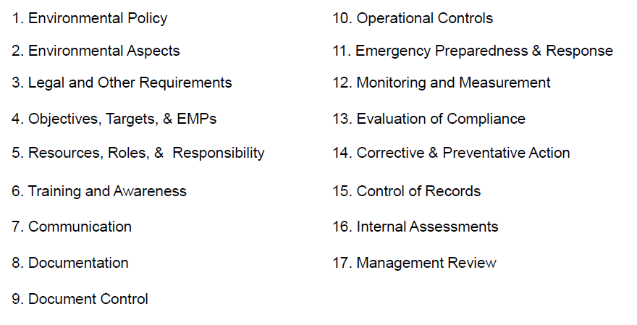
Overview of ISO 14001
17 Elements of ISO 14001

Slide 22
Basic Elements of ISO 14001
Environmental Policy
Review policy to ensure it aligns with EMS objectives
Include commitments as per ISO 14001
Aspects & Impacts
Assess environmental aspects and related impacts
Identify legal environmental requirements
EMS Objectives
Set environmental objectives to reduce environmental impacts
Comply with legal
Environmental Programs
Establish programs to meet EMS objectives
Notes:
In this example,

Slide 23
Basic Elements of ISO 14001
Management Review completes the cycle of the EMS by reviewing the progress of the EMS and making necessary improvements
Review
Check that the EMS is working as intended by conducting periodic internal audits
Audit
Monitor and measure progress in achieving EMS objectives
Monitor & Measure
Ensure all staff have an understanding of EMS and competency through environmental awareness and other necessary training. (i.e. internal auditing)
EMS Awareness Training
Notes:
In this example,

Slide 24
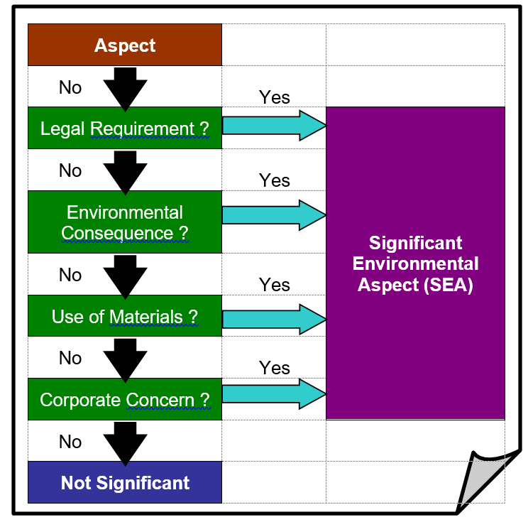
Significant Environmental Aspects
Significant Aspects drive your Priorities, Objectives and Programs
All potential and actual environmental impacts are identified and associated with an aspect.
The aspects are ranked for their significance.
It is important to identify Significant Aspects and plan to address them first.

Slide 25
Risk-based Thinking
An informal risk management system aimed at improvement.
Notes:
This is an example of how environmental aspects will be assessed for its significance.

Slide 26
EMS Objectives & Programs
Environmental Objectives
goals based on meeting compliance obligations and reducing negative impacts to the environment.
Measureable and achievable
Environmental Programs
Established for achieving objectives.
Action Plans to identify how objectives will be achieved.
Reduce impact of significant aspects
Address compliance to regulations
Improve objectives results
Outlines who, what, when, how, where

Slide 27
PART 1: Train the Trainer
3. Benefits

Slide 28
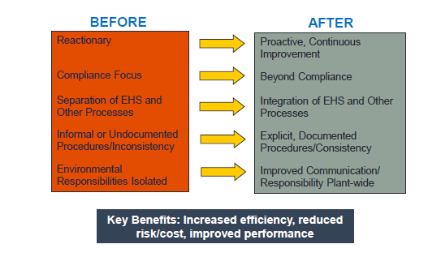
Benefits of Implementing an EMS
Enables identification of goals & ensure continual improvement
Improvements in overall environmental performance and compliance
Reduce environmental impacts in day-to-day operations
Proactive management can result in cost savings
Promotes a cleaner and safer work environment
Ensures funds and manpower are focused on highest risk priorities
Provides consistency during personnel turnover
Notes:
Other Potential Benefits
• Maintain or improve market access and competitiveness;
• A hidden benefit – overall operations improved by involving employees in the EMS implementation process.
• Demonstrate due diligence in the event of prosecution or litigation;
• Reduce environmental risk assessed by insurance and lending institutions;
• Increase employee involvement, morale, health and productivity.
Flexibility and opportunity to correct imperfections through “continual improvement”
Improved internal communication can support improved community relations – as the families of employees, neighbourhood, and surrounding community appreciate a business that demonstrates active concern and involvement in minimizing negative impacts on the environment.
Cost savings by reducing waste in their processes and reduction in resources usage (therefore reducing costs).
“compliance assurance,” recognizing that the EMS would help them to avoid costly environmental problems in the future. Also, bottom-line cost savings by implementing pollution prevention and energy efficiency projects identified as part of the EMS.
Identification of risk and prevention of problems – non-regulatory

Slide 29
Benefits of ISO 14001 Certification
Enhances public relations with external stakeholders
Competitive advantage – improved cost control, organizational effectiveness and image of organization
Improve employee involvement and motivation
Meet United Nations’ Sustainable Development Goals (SDGs)
ISO 14001 conformance & certification = credibility
Notes:
Other Potential Benefits
• Maintain or improve market access and competitiveness;
• A hidden benefit – overall operations improved by involving employees in the EMS implementation process.
• Demonstrate due diligence in the event of prosecution or litigation;
• Reduce environmental risk assessed by insurance and lending institutions;
• Increase employee involvement, morale, health and productivity.
Flexibility and opportunity to correct imperfections through “continual improvement”
Improved internal communication can support improved community relations – as the families of employees, neighbourhood, and surrounding community appreciate a business that demonstrates active concern and involvement in minimizing negative impacts on the environment.
Cost savings by reducing waste in their processes and reduction in resources usage (therefore reducing costs).
“compliance assurance,” recognizing that the EMS would help them to avoid costly environmental problems in the future. Also, bottom-line cost savings by implementing pollution prevention and energy efficiency projects identified as part of the EMS.
Identification of risk and prevention of problems – non-regulatory

Slide 30
PART 1: Train the Trainer
4. Keys to Success

Slide 31
Keys to a Successful EMS
A Successful EMS Starts with You!
Top Leadership Commitment
Focus on Continual Improvement
Build on existing procedures and processes
Flexibility
Adequate Resource Availability
Employee Awareness & Involvement
Employees must understand their responsibilities
Notes:
Environmental Responsibility built into employee objectives
Adequate employee awareness, understanding and involvement across company
Build an implementation team
Effective Audit Program

Slide 32
PART 2: Staff training
EMS Awareness

Slide 33
Learning Outcomes
General EMS Awareness Training
What is ISO 14001?
Benefits of ISO 14001
What is an Environmental Management System (EMS)?
Why are we implementing an EMS?
LDI’s Goal
Environmental Policy
Defining Environmental Aspects and Impacts
How Does the EMS Affect you and your job?
Your Role and Responsibility

Slide 34
What is ISO 14001?
ISO = International Organization for Standardization
ISO 14000 is the generic term for the series of international standards for environmental management.
Used by companies worldwide to prevent pollution by reducing waste, air emissions, water contamination, etc.
Certification attained through effective and successful implementation of an EMS.

Slide 35
Benefits of Implementing an EMS
Improvements in overall environmental performance and compliance
Reduce environmental impacts in day-to-day operations
Enhances public relations with external stakeholders
Promotes a cleaner and safer work environment
Ensures funds and manpower are focused on highest risk priorities
ISO 14001 conformance & certification = credibility
Notes:
Other Potential Benefits
• Maintain or improve market access and competitiveness;
• A hidden benefit – overall operations improved by involving employees in the EMS implementation process.
• Demonstrate due diligence in the event of prosecution or litigation;
• Reduce environmental risk assessed by insurance and lending institutions;
• Increase employee involvement, morale, health and productivity.
Flexibility and opportunity to correct imperfections through “continual improvement”
Improved internal communication can support improved community relations – as the families of employees, neighbourhood, and surrounding community appreciate a business that demonstrates active concern and involvement in minimizing negative impacts on the environment.
Cost savings by reducing waste in their processes and reduction in resources usage (therefore reducing costs).
“compliance assurance,” recognizing that the EMS would help them to avoid costly environmental problems in the future. Also, bottom-line cost savings by implementing pollution prevention and energy efficiency projects identified as part of the EMS.
Identification of risk and prevention of problems – non-regulatory

Slide 36
What is an EMS?
Uses a Plan, Do, Check, Act approach. It is a continuous cycle, not a one-time project, plan or initiative.
Focuses on continual improvement. Not focused only on regulatory compliance.
Everyone has a role in ensuring the EMS is a success. Incorporates and promotes environmental awareness, pollution prevention, conservation of natural resources into all business activities, not an effort only for the environmental department.
Helps to accomplish goals related to sustainability, pollution prevention, and environmental compliance.
Promotes Environmental Stewardship

Slide 37
Why Develop and Implement an EMS?
1. Demonstrates leadership within our industry.
2. Take responsibility for the impact we have on the environment.
Notes:
Also demonstrates leadership in your industry.
Take responsibility for the impact we have on the environment

Slide 38
Our Goal
Corporate requirement to become certified in ISO 14001:2015 by Spring 2024.
Notes:
Also demonstrates leadership in your industry.
Take responsibility for the impact we have on the environment

Slide 39
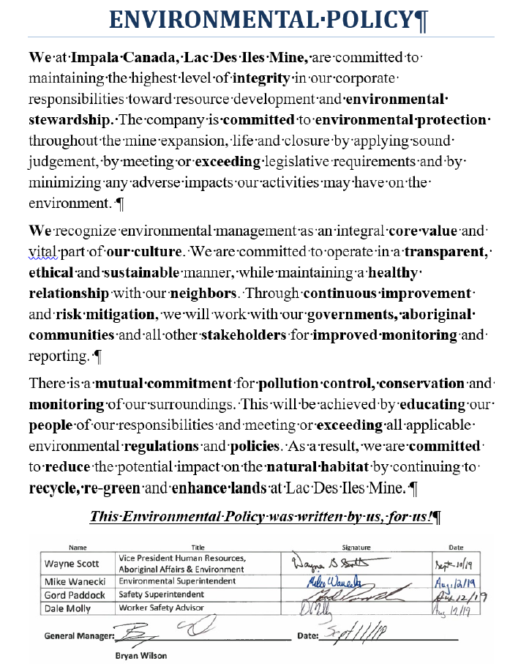
Environmental Policy
Commitment To:
Protecting the Environment & Prevention of Pollution
Includes:
Sustainable Resource Use
Climate Change Mitigation
Protection of Biodiversity and Ecosystems
Fulfill Compliance
Obligations
Continual Improvement
Improvement of the EMS to enhance performance
Notes:
Diana to add screenshot of Policy

Slide 40
Defining Environmental Aspects and Impacts
An Aspect is an element of an organization’s activities, products or services that can interact with the environment
An Impact is any change to the environment resulting from an organization’s activities, products or services (aspects)
can be negative or positive
whole or partial change
What forms the groundwork of the EMS?
Notes:
Environmental Impacts
Environmental attributes of products, activities and services and their effects on the environment
Impacts can take place at your facility (spilling oil) or offsite (vehicle emissions)

Slide 41
Defining Environmental Aspects and Impacts
What aspect is involved in your workplace?
What is a related impact?
Example:
Negative
ASPECT - Electricity use
IMPACT - Air Pollution, Global warming
ASPECT – Reusing treated water
IMPACT - Conservation of natural resources
Positive

Slide 42
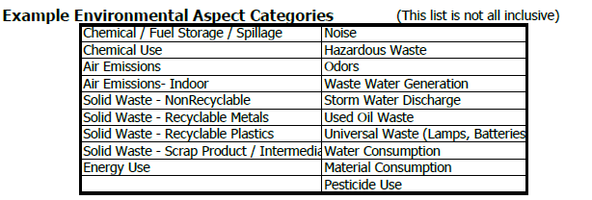
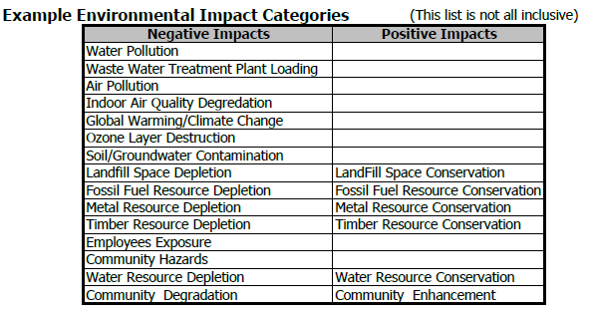
Examples of Aspects and its Impacts
Notes:
Can be associated with any type of work, service, product or activities.

Slide 43
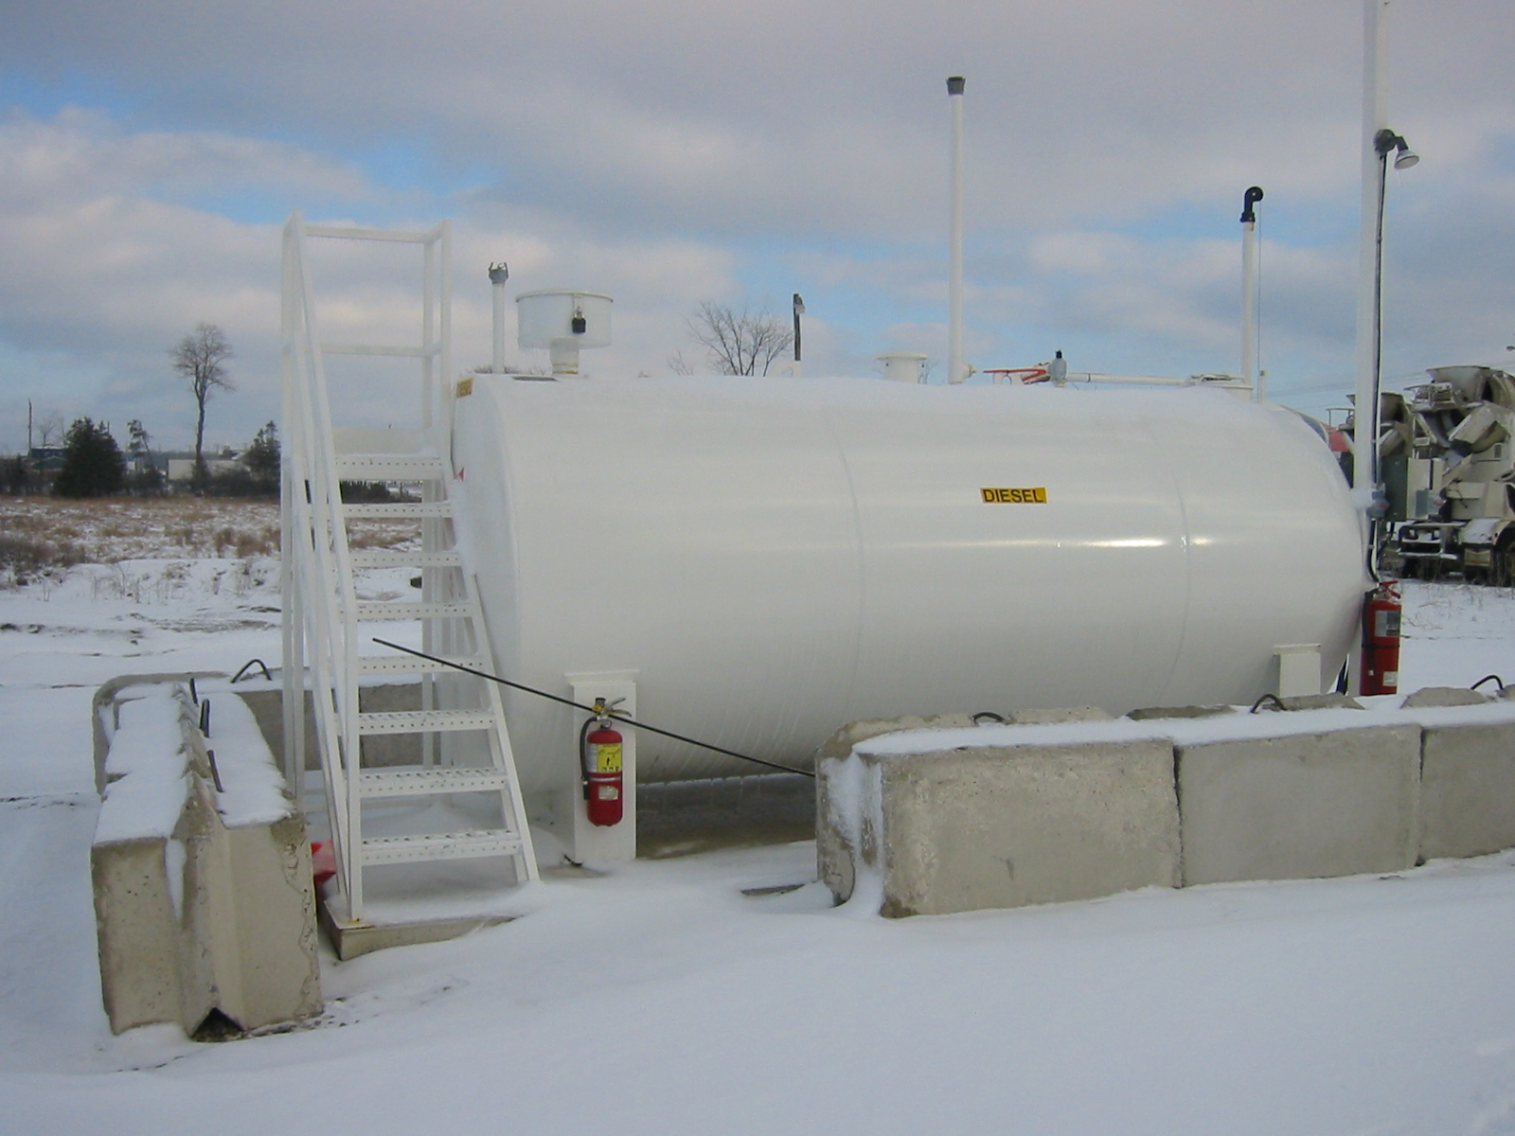
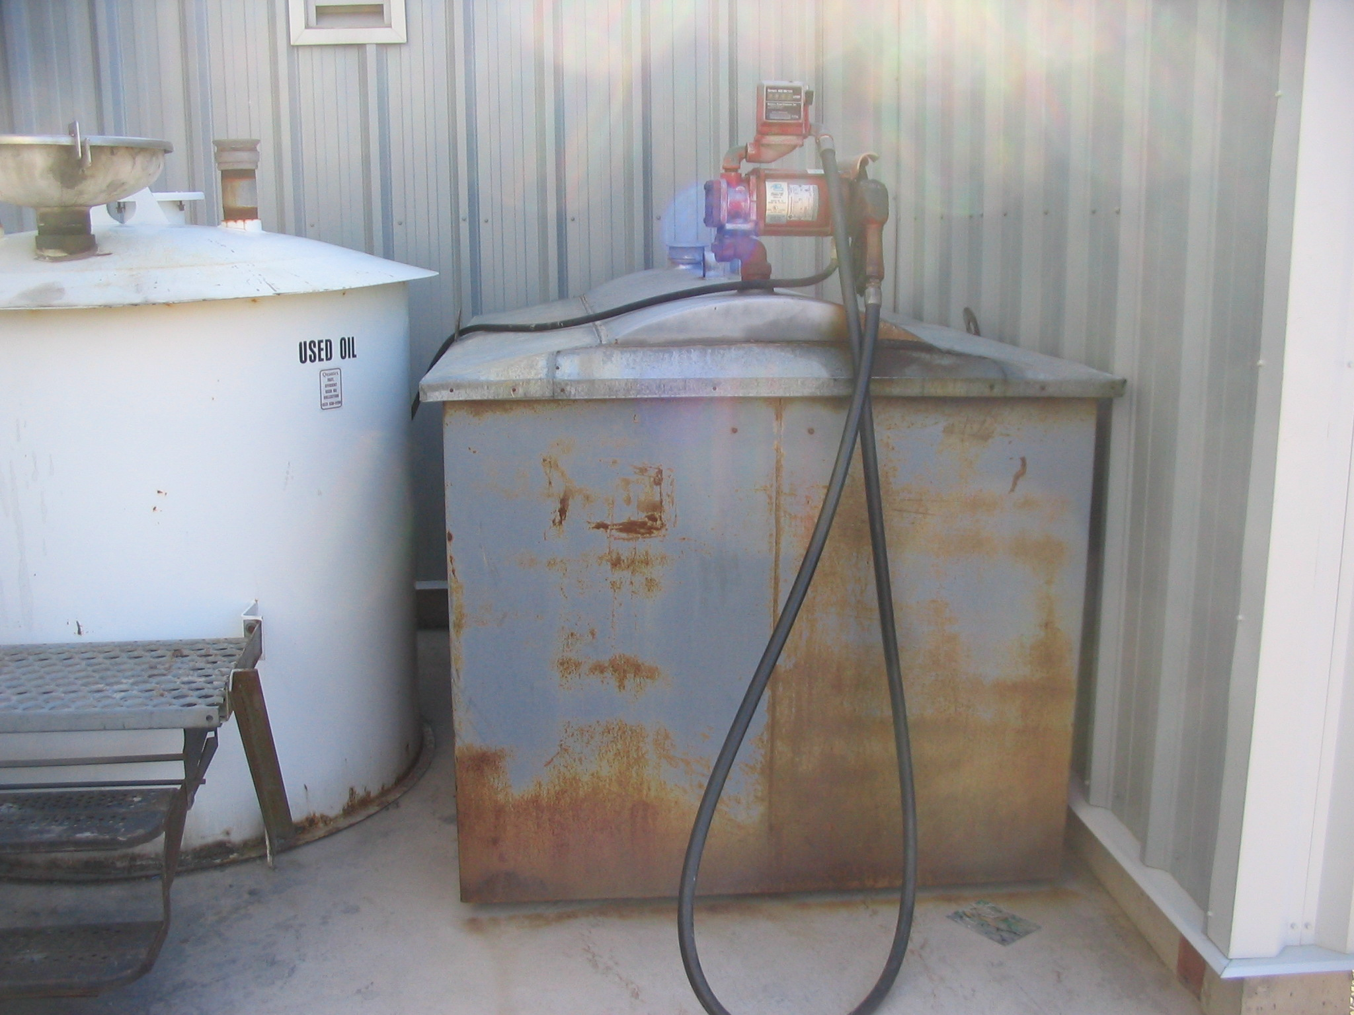
How does your job affect the environment?
ASPECT:
Storage and use of diesel fuel.
IMPACT:
Potential spill/leak of fuel and/or incorrect disposal can
pollute water.
Notes:
Can be associated with any type of work, service, product or activities.

Slide 44
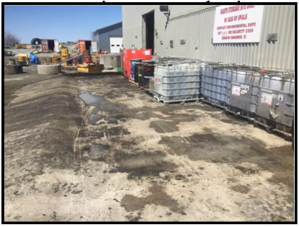
How does your job affect the environment?
ASPECT:
Waste Oil containment area
IMPACTS:
Land contamination if spilled
Water contamination
Notes:
Can be associated with any type of work, service, product or activities.

Slide 45
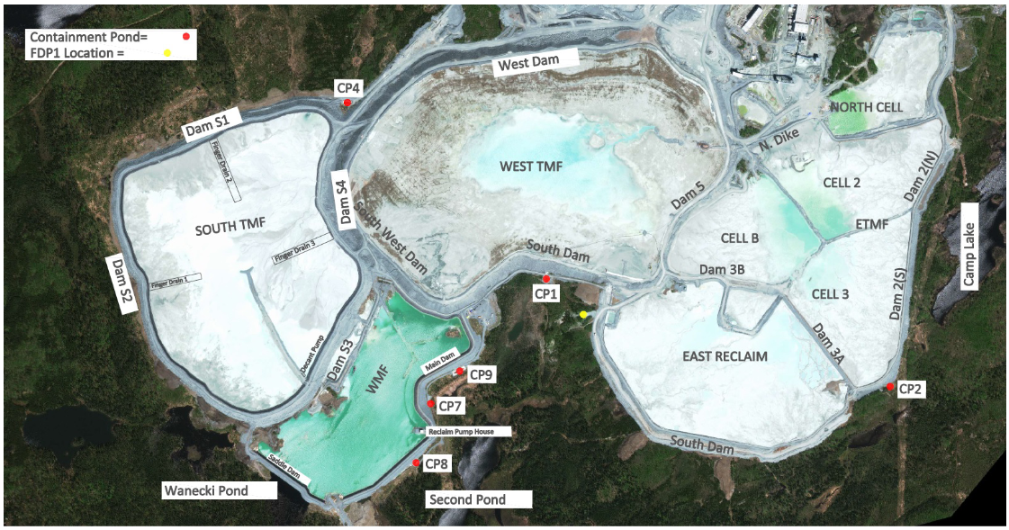
How does your job affect the environment?
ASPECT:
Dam inspection in tailings
management
Design integrity
IMPACTS:
Soil erosion
Spills from tailings solids, reclaim water/effluent
Notes:
Can be associated with any type of work, service, product or activities.

Slide 46
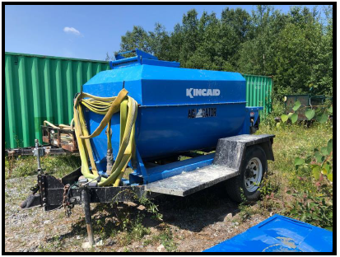
How does your job affect the environment?
ASPECT:
Hydro seeding
IMPACTS:
Dust suppression
Erosion control, land reclamation, soil remediation.
Notes:
Can be associated with any type of work, service, product or activities.

Slide 47
Your Role and Responsibility in EMS
Know your environmental policy
Know your organization’s role in achieving and maintaining the EMS
(environmental aspects, goals, and environmental management programs)
Work according to Standard Operating Procedures (SOPs)
Recognize the environmental impacts of your job
Identify and correct problems
Reduce environmental footprint
Suggest ways to improve
Notes:
Do the right thing to make sure that you aren’t polluting the air, land or water
Know how to properly manage activities and prevent harm – follow SOP’s
The job you are doing can make a difference in the surrounding community
Conserve natural resources and prevent pollution
Minimize the impacts of your activities
Recycle as much as you can
Use a less toxic material
Be energy efficient
Purchase products containing recyclable materials

Slide 48
Questions?

Slide 49
Thank You
Connie Lum, MA, BSc., EP(CEA)
+1 519 635 2286
connie@envirolum.com
www.envirolum.com

